Slide 1

DUR SNAILS OF CAL POLY POMONA
LOPEZ URBAN FARM LOGGING SYSTEM
Olive Stam, Timothy Jo, Diego Mejia, Casey Wong, Matthew Yeung

Slide 2
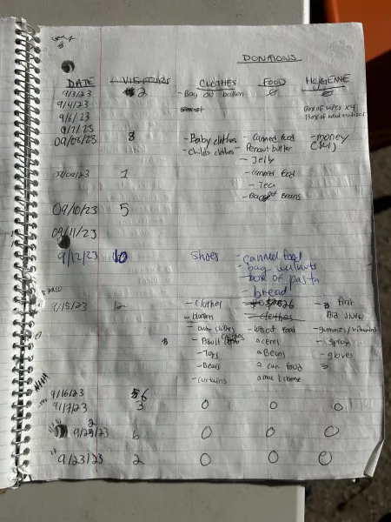
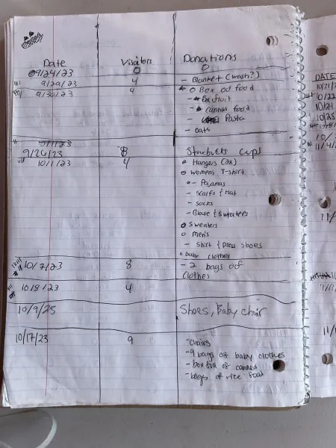
Project Background
Lopez Urban Farm uses pen and paper to log their donations.
Entry includes date, number of visitors, and donations
This method is unreliable and ineffective. Workers want a more efficient alternative.

Slide 3
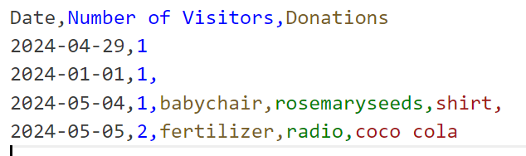
Our Solution
Create a program that allows for donations to be logged and retrieved in a more efficient manner.
Donations will be logged and stored by dates
Allow for entries to be retrieved by entering a specific date or a range of dates.
All logged donations on those dates will be returned.

Slide 4
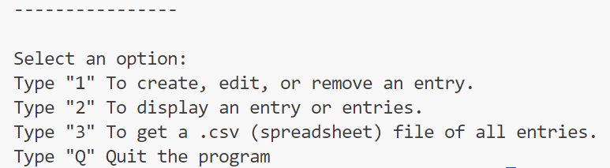
Our Solution
4 User Options
Option 1 - Create/Edit/Delete a Specific Entry
Option 2 - Display Entry or Range of Entries
Option 3 - List all Entries in a comma separated value file.
Option 4 - Quit the Client

Slide 5
Our Solution
Data Structures used
Bag - used to store donations, used as a instance variable of Entry.java
Since donations do not need to be ordered and duplicates can exist.
List - used to store entries in EntryList.java
Can be easily accessible and more organized
BAG
Outdoor boots
Rosemary seeds
Ball of fluff
babychair
BAG
BAG
BAG
BAG
LIST

Slide 6
Demo

Slide 7
How the Application improves the Farm
By using our app, recording and retrieving donation information will be more efficient.
Instead of having to flip through a book and manually look for dates, they can instead pull information out by typing in a date or a range of dates.
They can also transfer their old entries into an excel sheet and add those to the program without any issues as well. This way, they can keep track of donations before and after the program was made.

Slide 8
How we can Improve the Project
One way we can improve the project is by giving them the option to search by donation entry type.
For example, if they wanted clothes only, we could add the ability to let them search for dates that include clothes.
Another way could be giving them the option to filter entries with specific donations types.
So if they gave us a range of dates and asked is to list the ones that have clothes, we can add a filter function that will return the dates and entries that have clothes.
Turning our project into a web page or app to make accessing and using the program more easier.

Slide 9
CONTRIBUTIONS
Olive Stam
Created the project schedule and chat
Created EntryList.java and EntryListTest.java, worked on Client.java, interfacing, and javadoc
Timothy Jo
Worked on Interface files, ResizableArrayBag.java, Client.java, added javadoc comments
Worked on both Technical Paper and Slides
Diego Mejia
Created Entry.java and javadoc, added features to Client.java
Worked on slides
Casey Wong
Worked on early code file drafts (some were scrapped)
Matthew Yeung
Worked on slides
Made paper skeleton plan

